Slide 1
WIT ACE HACKATHON
Team Challenger
Divya Gupta
Ashish Kumar
Anchal Bhanwala
Sushant Mishra
Swapan Sharan (Mentor)

Slide 2
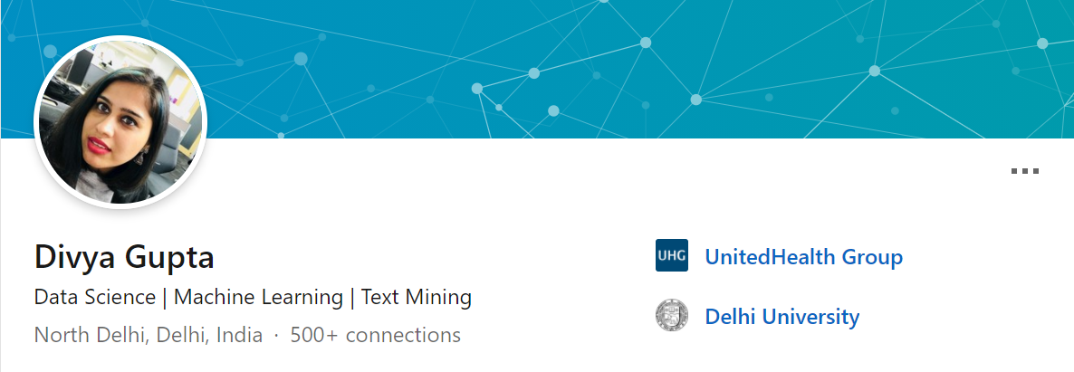

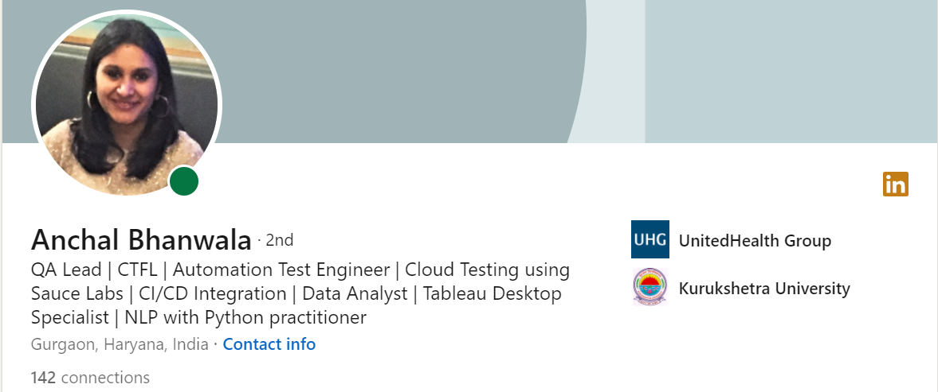

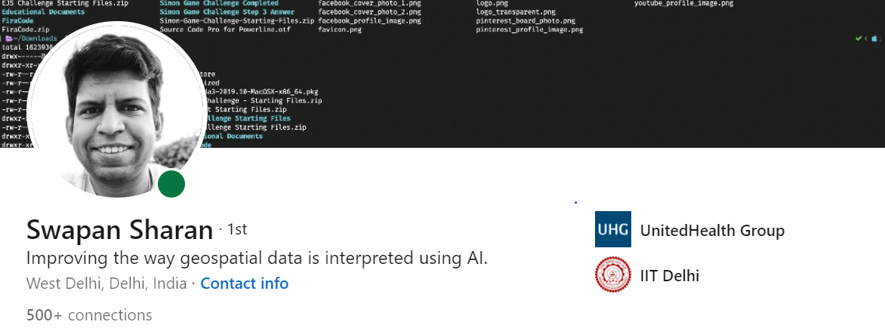
Team Challenger
A bunch of highly motivated enthusiasts, trying to make sense out of data in their everyday life

Slide 3
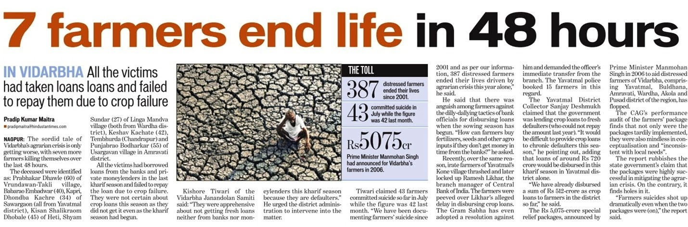

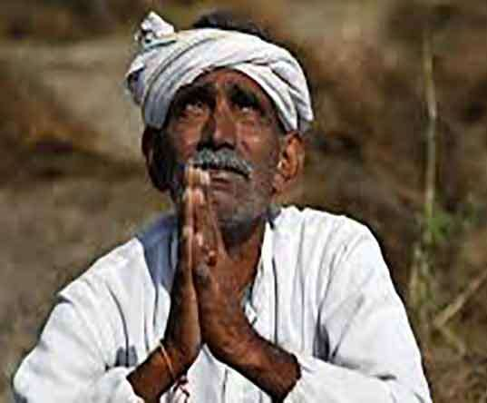
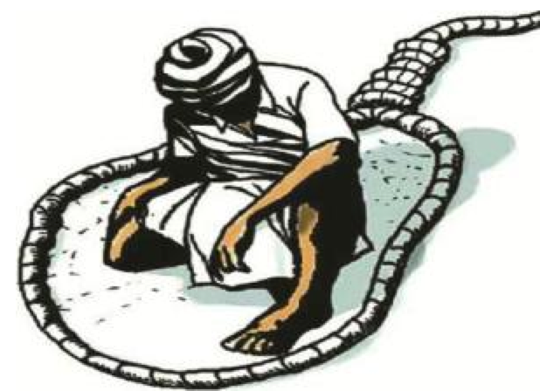

Slide 4
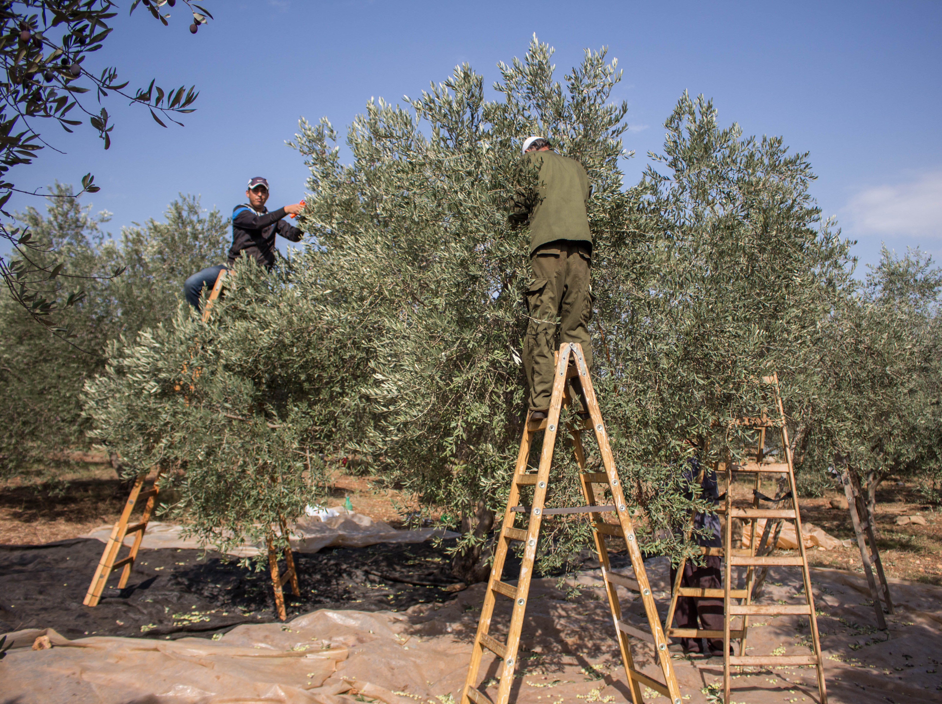
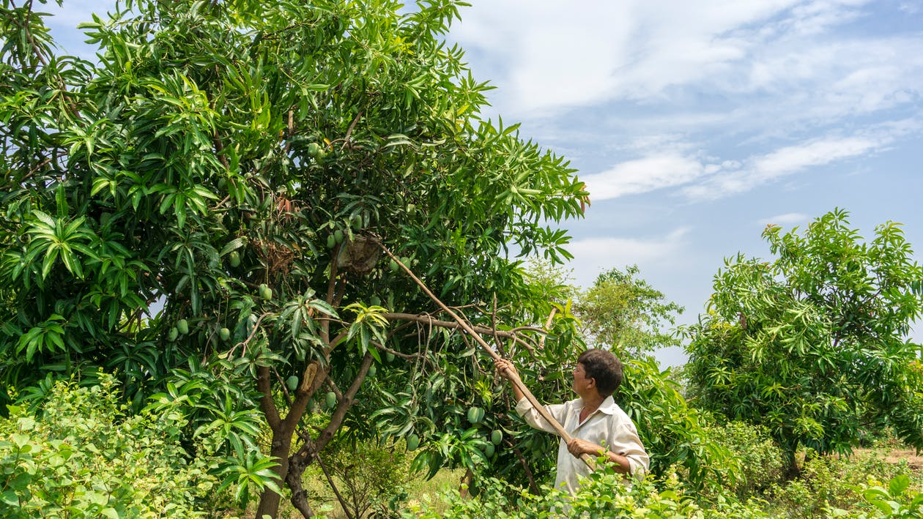
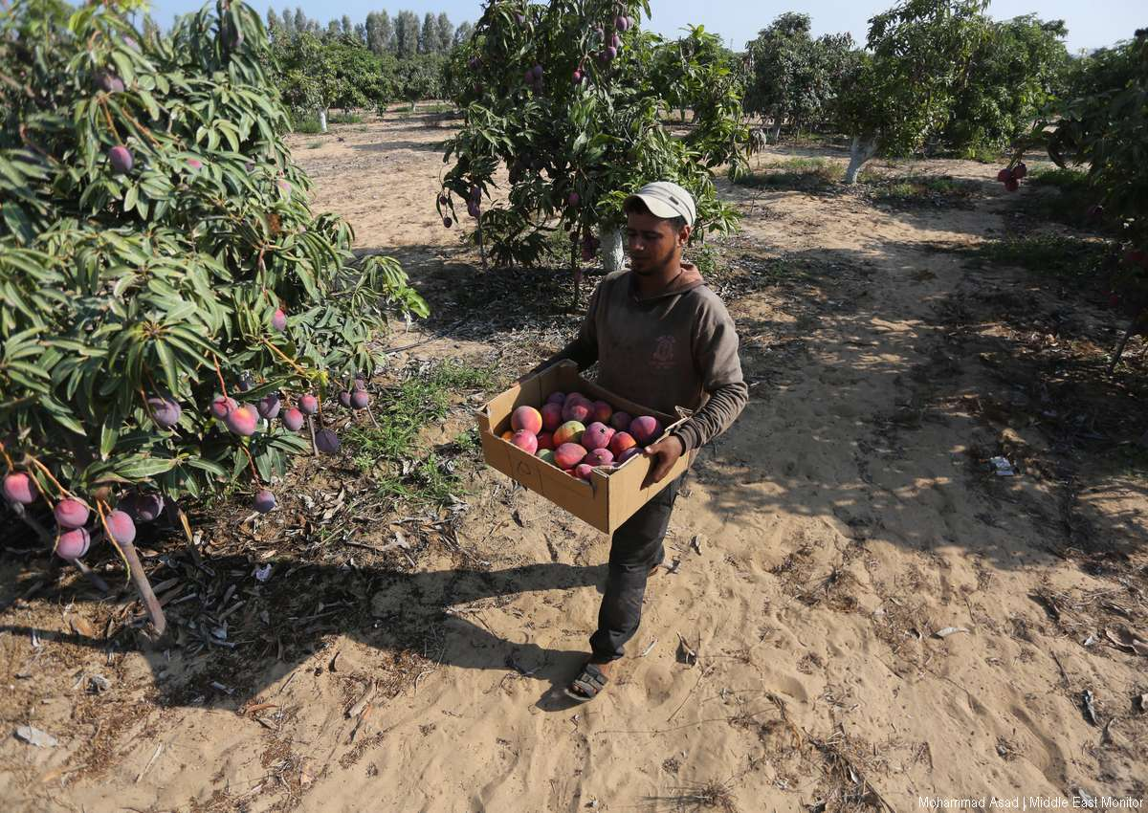

Slide 5
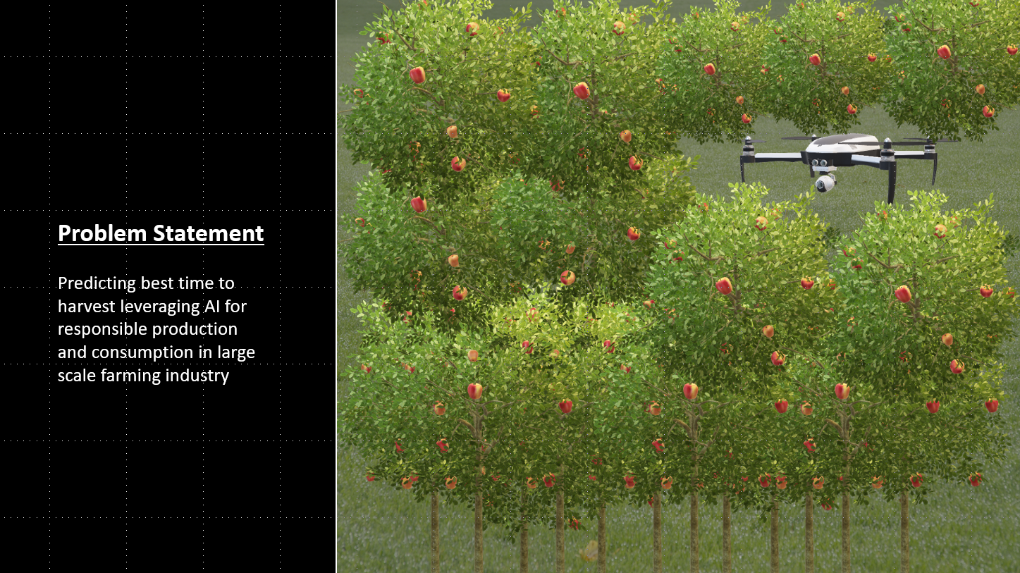

Slide 6


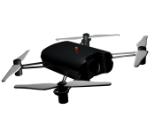



Solution Roadmap
Fast AI - UNET
Architecture
1.
2.
3.
4.
5.
Farmer
Drone Images
Cloud Storage
API - Image Segmentation
UI – Ripeness Outcome

Slide 7
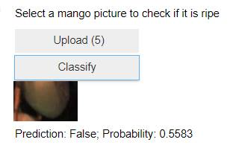
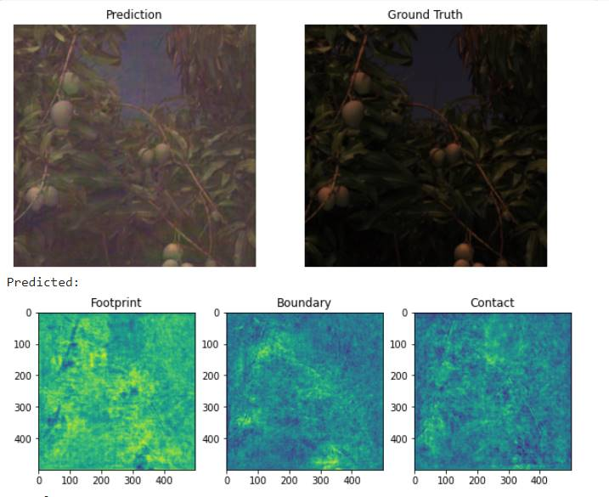
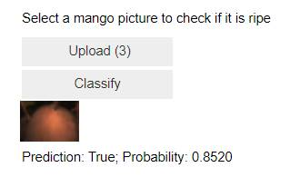

Slide 8
Next Steps
Model Improvement – Accuracy at more granular level ( distinction in color compositions of ripped fruits)
State of the art solution - Scalable to all types of fruits and/or crops
Cloud based app development

Slide 9
Divya Gupta +91 9711726701 Ashish Kumar +91 8750807666 Sushant Mishra +91 7701829180 Anchal Bhanwala +91 9971711610
Thank You

